Slide 1
Knowledge Editing and Machine Unlearning for Large Language Models
Group No.: 40
Name: Preethi G
Roll. No.: AI23MTECH14005

Slide 2
Knowledge Editing
Task Definition:
Deployed models make unpredictable errors. For example, LLMs hallucinate, perpetuate bias, and factually decay.Thus goal is to adjust specific behaviors of pre-trained models.
Why do we need a new method called Knowledge Editing?
What is the main challenge when it comes to updating LLMs?
Typical steps in Knowledge Editing:
Resorting to External Knowledge
Merging Knowledge into the Model
Editing Intrinsic Knowledge
What is Knowledge Editing?
Notes:
LLMs have shown extraordinary capabilities in understanding and generating text that closely mirrors human communication. However, a primary limitation lies in the significant computational demands during training, arising from their extensive parameterization.
But
The main challenge is that the world is dynamic in nature which necessitates frequent updates to LLMs to correct outdated information or integrate new knowledge, thereby ensuring their continued relevance. Note that many applications demand continual model adjustments post-training to address deficiencies or undesirable behaviors.
Knowledge Editing aims to efficiently modify LLMs’ behaviors within specific domains while preserving overall performance across various inputs. Traditional methods encode new knowledge in pre-trained LLMs through methods like direct fine-tuning. But we know that, naively re-training LLMs can be computationally intensive and it also risks degenerating some of the pre-trained knowledge that are irrelevant to the current update that we are trying to do in the model. So when new tasks are encountered, their performance significantly degrades on older tasks due to catastrophic forgetting. Now, knowledge editing methods try to modify the LLMs to incorporate specific knowledge, without negatively influencing other previous knowledge that the model has.
• Resorting to External Knowledge. This kind of approach is similar to the recognition phase in human cognitive processes, which needs to be exposed to the new knowledge within a relevant context, just as people first encounter new information. For example, providing sentences that illustrate a factual update as a demonstration of the model, allowing initial recognition of the knowledge to be edited.
• Merging Knowledge into the Model. This kind of approach closely resembles the association phrase in human cognitive processes, in which connections are formed between the new knowledge and existing knowledge in the model. Methods would combine or substitute the output or intermediate output with a learned knowledge representation.
• Editing Intrinsic Knowledge. This approach to knowledge editing is akin to the mastery phase in human cognitive processes. It involves the model fully integrating knowledge into its parameters by modifying the weights and utilizing them reliably.

Slide 3
Methods to update newer Knowledge | Fewer Params | Precise Control | Support Phenomena
Finetune | ✗ | ✗ | +
Parameter-efficient Fine-Tuning | ✔ | ✗ | +
Knowledge Augmentation | ✔ / ✗ | ✗ | +
Continual Learning | ✗ | ✗ | +
Model Unlearning | ✔ / ✗ | ✗ | -
Knowledge Editing | ✔ | ✔ | +/-
Reference: https://arxiv.org/pdf/2401.01286.pdf (A Comprehensive Study of Knowledge Editing for Large Language Models)

Slide 4
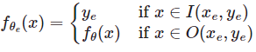
Knowledge Editing
Knowledge editing aims to adjust an initial base model's (f_θ) behavior(x_e -> y_e) on the particular edit descriptor [x_e,y_e] efficiently. There are usually three forms of Factual Knowledge Editing:
Knowledge Insert
Inject knowledge that LLMs have not seen before. such as:
What company owns Gemini AI? (Not found before) -> Google
Knowledge update
LLMs suffer from knowledge cutoff issue and Knowledge Editing can update outdated knowledge. Such as:
The president of USA: Donald Trump -> Joe Biden
How many times has Messi won the World Cup? 0 -> 1
Knowledge erase
Knowledge Editing can also be used to erase sensitive information. such as:
The phone number of someone is XXXX -> ——
Without influencing the model behavior on unrelated samples, the ultimate goal is to create an edited model.
Continuous Knowledge Editing
On the basis of factual editing, this approach requires sequentially editing each knowledge instance, and evaluation must be performed after all knowledge updates have been applied:
θ′ ← argmin(e=1∑∥X_e∥) (∥f_θ(x_e )−y_e∥)
Make parameter adjustments for a specific input-output pair (x_e,y_e), where x_e ∈ X_e and f’_θ(x_e) = y_e. Here, X_e represents the entire set to be edited.
The knowledge editing process generally impacts the predictions for a broad set of inputs that are closely associated with the edit example, called the editing scope. A successful edit should adjust the model’s behavior within the editing scope while remaining unrelated inputs:

Slide 5
Knowledge Editing example:
Credits: https://github.com/zjunlp/EasyEdit/tree/main

Slide 6
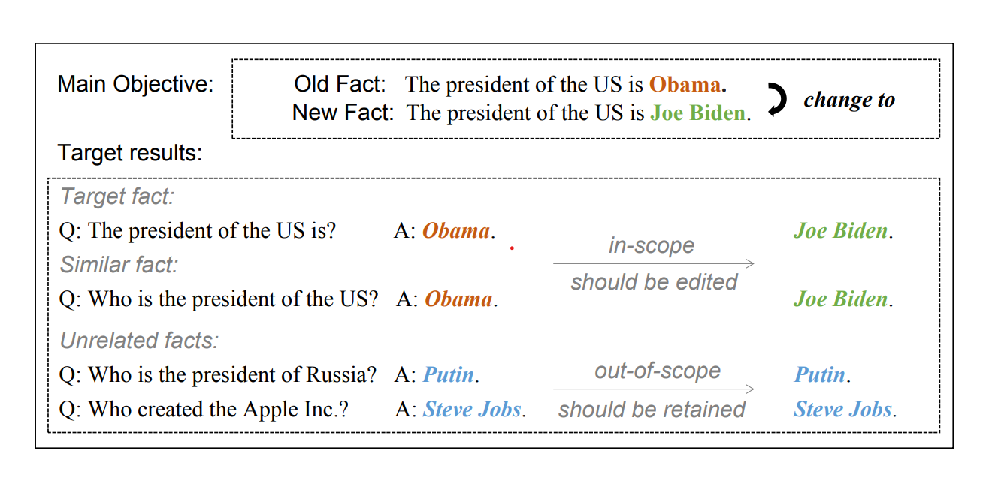
Knowledge Editing example:

Slide 7
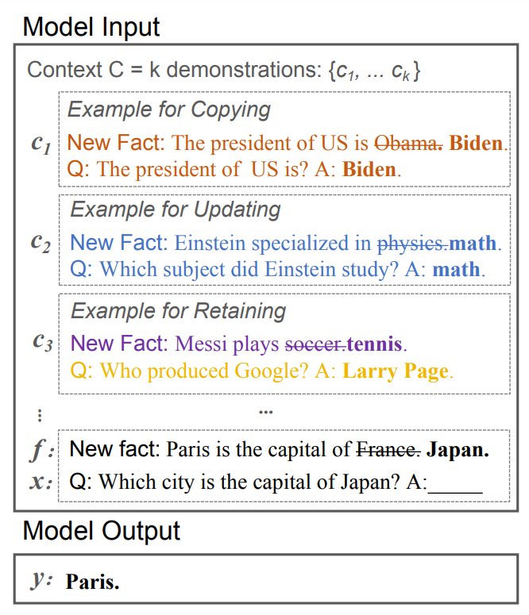

Slide 8
Dataset and Models
Knowledge Modification Dataset - Question Answering: Zero-Shot Relation Extraction (ZsRE) - (around 10k data points for training, 1301 data points for testing)
Initial Structure:
Subject, Prompt, Ground Truth, Target, Rephrase Prompt, Condition, Locality(Relation_Specificity-Prompt, Ground Truth), Portability(Prompt, Ground Truth)
Required Structure:
Subject, Prompt, Ground Truth, Target, Rephrase Prompt, Locality(Relation_Specificity-Prompt, Ground Truth {taking 1st out of multiple prompts})
Experiment Models:
GPT-2-XL with ROME
GPT-2-XL with MEMIT

Slide 9
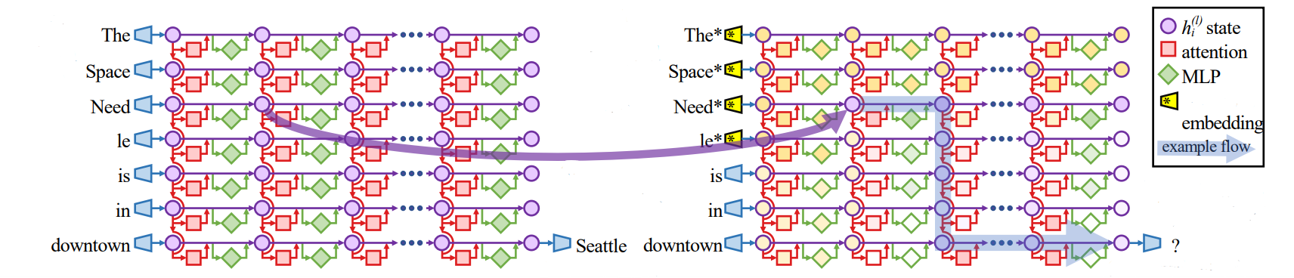
Overview of Rank-One Model Editing (ROME)
Prompt
Interventions on Weights for Understanding Factual Association Storage
Viewing the Transformer MLP as an Associative Memory
Credits: https://arxiv.org/pdf/2202.05262.pdf
Notes:
The paper analyzes the storage and recall of factual associations in autoregressive transformer language models, finding evidence that these associations correspond to localized, directly-editable computations. The paper reveals a distinct set of steps in middle-layer feed-forward modules that mediate factual predictions while processing subject tokens. To test this hypothesis that these computations correspond to factual association recall, the authors modify feedforward weights to update specific factual associations using Rank-One Model Editing (ROME). ROME is effective on a standard zero-shot relation extraction (zsRE) model-editing task. The paper results confirm an important role for mid-layer feed-forward modules in storing factual associations and suggest that direct manipulation of computational mechanisms may be a feasible approach for model editing.

Slide 10
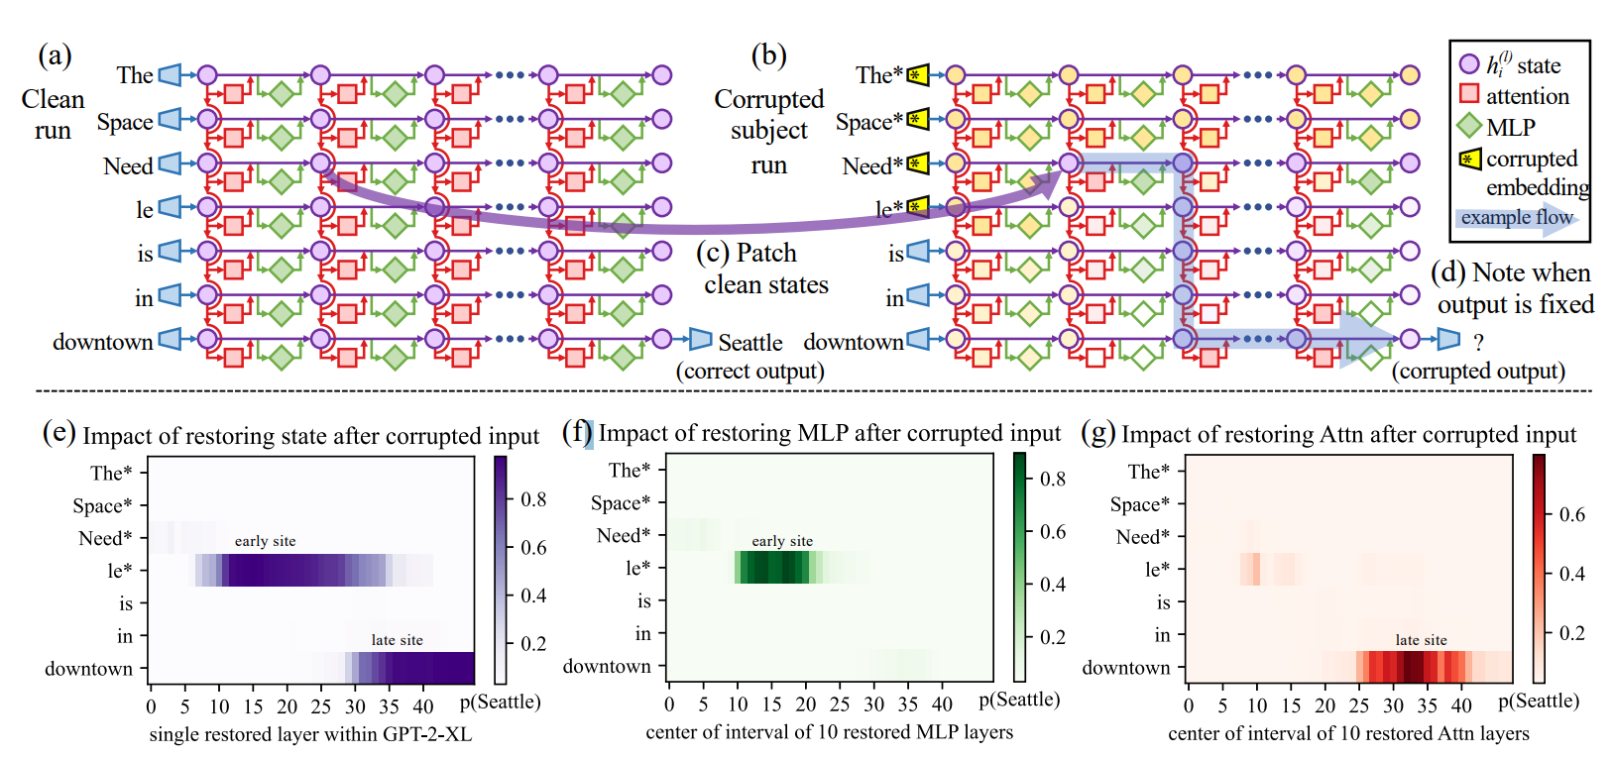
Causal Effect of neuron activations in ROME
Credits: https://arxiv.org/pdf/2202.05262.pdf
Notes:
The paper analyzes the storage and recall of factual associations in autoregressive transformer language models, finding evidence that these associations correspond to localized, directly-editable computations. The paper reveals a distinct set of steps in middle-layer feed-forward modules that mediate factual predictions while processing subject tokens. To test this hypothesis that these computations correspond to factual association recall, the authors modify feedforward weights to update specific factual associations using Rank-One Model Editing (ROME). ROME is effective on a standard zero-shot relation extraction (zsRE) model-editing task. The paper results confirm an important role for mid-layer feed-forward modules in storing factual associations and suggest that direct manipulation of computational mechanisms may be a feasible approach for model editing.

Slide 11
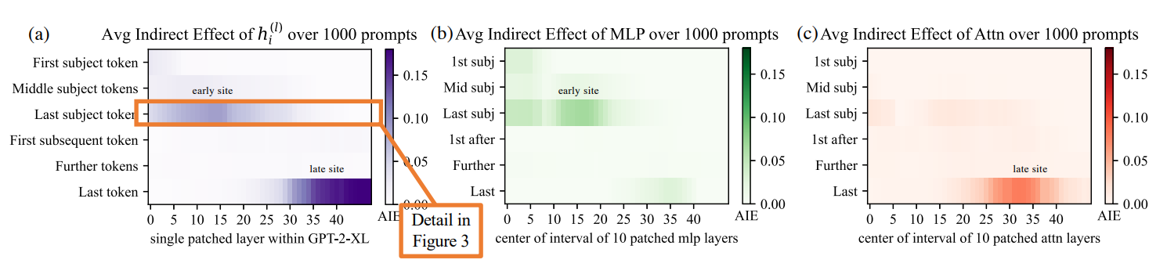
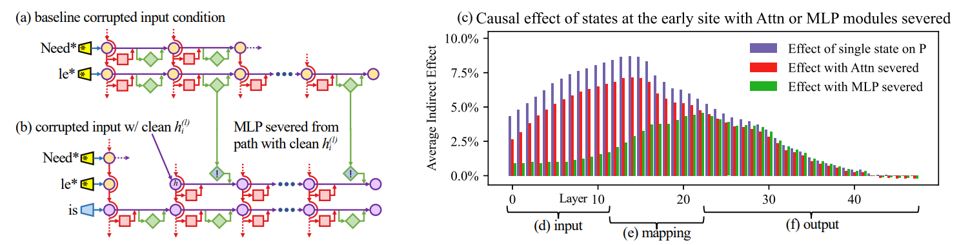
Causal Effect of neuron activations in ROME
Credits: https://arxiv.org/pdf/2202.05262.pdf
Notes:
The paper analyzes the storage and recall of factual associations in autoregressive transformer language models, finding evidence that these associations correspond to localized, directly-editable computations. The paper reveals a distinct set of steps in middle-layer feed-forward modules that mediate factual predictions while processing subject tokens. To test this hypothesis that these computations correspond to factual association recall, the authors modify feedforward weights to update specific factual associations using Rank-One Model Editing (ROME). ROME is effective on a standard zero-shot relation extraction (zsRE) model-editing task. The paper results confirm an important role for mid-layer feed-forward modules in storing factual associations and suggest that direct manipulation of computational mechanisms may be a feasible approach for model editing.

Slide 12
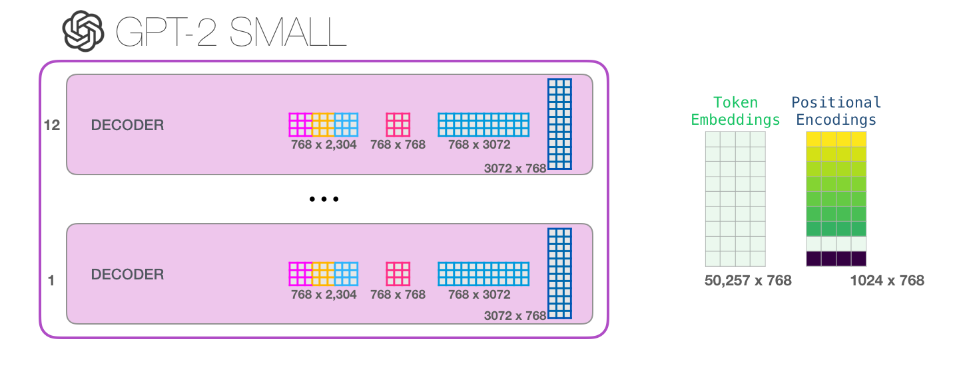
Baseline Model - GPT2-XL
GPT-XL -> 48 Decoder blocks, Model Dimensionality: 1600
GPT2LMHeadModel(
(transformer): GPT2Model(
(wte): Embedding(50257, 1600)
(wpe): Embedding(1024, 1600)
(drop): Dropout(p=0.1, inplace=False)
(h): ModuleList(
(0-47): 48 x GPT2Block(
(ln_1): LayerNorm((1600,), eps=1e-05, elementwise_affine=True)
(attn): GPT2Attention(
(c_attn): Conv1D()
(c_proj): Conv1D()
(attn_dropout): Dropout(p=0.1, inplace=False)
(resid_dropout): Dropout(p=0.1, inplace=False)
)
(ln_2): LayerNorm((1600,), eps=1e-05, elementwise_affine=True)
(mlp): GPT2MLP(
(c_fc): Conv1D()
(c_proj): Conv1D()
(act): NewGELUActivation()
(dropout): Dropout(p=0.1, inplace=False)
)
)
)
(ln_f): LayerNorm((1600,), eps=1e-05, elementwise_affine=True)
)
(lm_head): Linear(in_features=1600, out_features=50257, bias=False)
)
Credits: https://jalammar.github.io/illustrated-gpt2/

Slide 13
Results:
Training:
[{'pre': {'rewrite_acc': [0.33], 'portability': {}}, 'case_id': 0, 'requested_rewrite': {'prompt': 'Who was the designer of Lahti Town Hall?', 'target_new': 'Alfred Lahti', 'ground_truth': 'Eliel Saarinen', 'portability': {}, 'locality': {}, 'subject': 'Lahti Town Hall'}, 'time': 7.94, 'post': {'rewrite_acc': [1.0], 'locality': {}, 'portability': {}}}
Reliability: (Input is direct prompts)
Pre-Edit Outputs: ['Who was the designer of Lahti Town Hall? The designer of Lahti Town Hall was the architect, architect and designer of the Lahti']
Post-Edit Outputs: ['Who was the designer of Lahti Town Hall? Alfred Lahti. He was a great designer. Actually, what did Lahti Town Hall mean? It was a town in']
Generalization: (Input is Rephrased Prompts)
Pre-Edit Outputs: ['Who was the architect behind the design of Lahti Town Hall?\n\nThe architect was a young architect named Kari Kari. He’]
Post-Edit Outputs: ['Who was the architect behind the design of Lahti Town Hall? Alfred Lahti. And who designed the Town Hall in Lahti? Alfred']
Locality: (Input is Locality Prompts i.e. the main subject is different but Question is of similar context)
Pre-Edit Outputs: ['Who was the designer of Eiffel Tower? The Eiffel Tower was designed by Gustave Eiffel']
Post-Edit Outputs: ['Who was the designer of Eiffel Tower? The Eiffel Tower was designed by Gustave Eiffel']

Slide 14
Experiment Evaluation across Different Evaluation Metrics
Name | Reliability test | Generalization test | Locality test
GPT-2-XL ROME | 93.57 | 86.9 | 86.3
LlaMA-2-7B ROME (paper) | 92.45 | 87.04 | 99.63
GPT-2-XL MEMIT | 83.07 | 84.3 | 78.9
LlaMA-2-7B MEMIT (paper) | 92.94 | 85.97 | 99.49
Source: Editing Performance: Editing Results of the four metrics on LlaMA-2-7B https://github.com/zjunlp/EasyEdit/blob/main/README.md

Slide 15
Thank you
😄

